Slide 1

IOT-BASED CONTACTLESS BODY TEMPERATURE SCANNING SYSTEM FOR SMART AND SAFE CAMPUS
Department of Electronics and Communication Engineering
Jawaharlal Nehru Technological University Hyderabad
University College of Engineering Jagtial
By:
B. Sai Shankar (19JJ1A0407)
A. Chandravadan (19JJ1A0401)
Md. Arbaz (19JJ1A0429)
Project Guide:
Dr. Dhiraj Sunehra
Professor & Head (ECE)

Slide 2

Introduction
Aim and Objectives of the Project
Block Diagram
Hardware Description
Software Tools
Experimental Setup
Flowchart
Results and Discussion
Conclusions
References

Slide 3
INTRODUCTION:
During a pandemic situation, everyone is required to check the body temperature and record personal details whenever they enter the campus.
When the security officer checks the body temperature of students using a conventional thermometer, there is a possibility of spread of infection due to physical contact and it takes more time for the measurement.
So, in order to avoid physical contact, we can use an IoT-Based Contactless Body Temperature Scanning System for measuring temperature, creating alerts and upload data to Blynk app.

Slide 4
Aim and Objectives of the project:
Aim of the Project:
Objectives of the Project:
To develop a contactless temperature scanning system for a smart and safe campus environment.
To understand the salient features and architecture of Node MCU, Arduino IDE and Blynk IoT app.
To develop the necessary code using embedded C language in Arduino IDE.
To interface the sensors with Node MCU Board and to detect the Temperature and alert the abnormal temperature by using buzzer and LED.

Slide 5
Block diagram of project:
Blynk app
Temperature
Sensor
Node MCU
BUZZER
RFID Scanner
LED-RED
And
LED-GREEN
LCD DISPLAY

Slide 6
Hardware Description:
NODE MCU
CONTACTLESS TEMPERATURE SENSOR
LCD DISPLAY
RFID EM 18 READER MODULE
BUZZER
LED

Slide 7
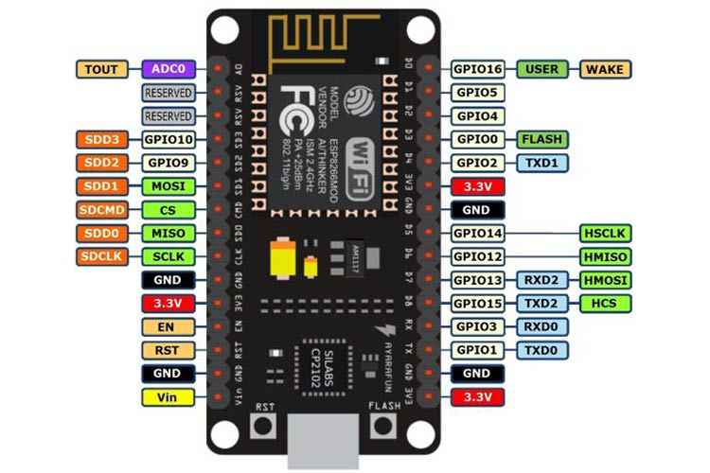
Node MCU:
NodeMCU ESP8266 Specifications & Features:
Operating Voltage: 3.3V
Input Voltage: 7-12V
Digital I/O Pins (DIO): 16
Analog Input Pins (ADC): 1
UARTs: 1
Flash Memory: 4 MB
SRAM: 64 KB
Clock Speed: 80 MHz
PCB Antenna
Fig: Node MCU Pinout

Slide 8
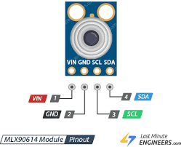
MLX-90614-Temperature sensor:
Fig:MLX90614 Pin Out Diagram
The MLX90614 is an Infrared thermometer for noncontact temperature measurements.
The MLX90614 offers a standard accuracy of ±0.5ºC around room temperatures.

Slide 9
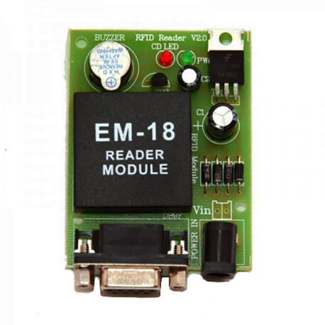
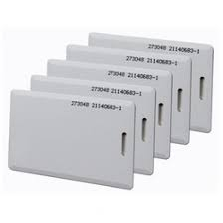
EM-18 READER MODULE:
Fig1:RFID SCANNER
Fig2:RFID TAGS
EM-18 RFID reader is one of the commonly used RFID reader to read 125 KHz tags.
RFID is used in many applications like attendance system in which every person will have their separate RFID tag which will help identify person and their attendance.

Slide 10
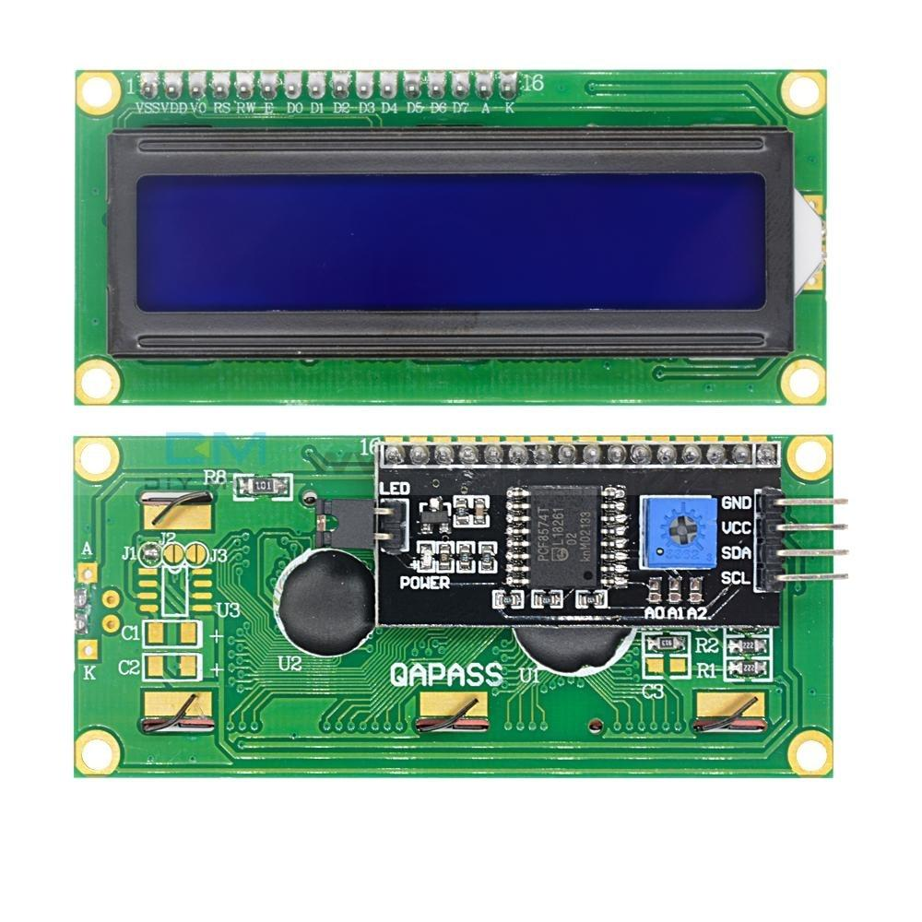
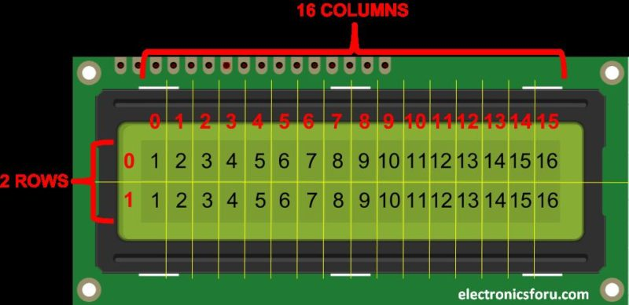
Liquid Crystal Display(LCD):
Fig1:LCD [2x16] overview
Fig2:pixel orientation
Figure1
Figure2
LCD (Liquid Crystal Display) is a type of flat panel display which uses liquid crystals in its primary form of operation.
LCDs are used in a wide range of applications, including LCD televisions, computer monitors, instrument panels, aircraft cockpit displays, and indoor and outdoor signage.

Slide 11
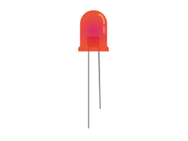
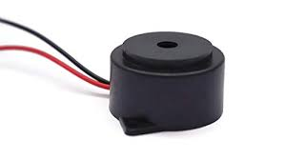
BUZZER AND LED:
Fig1:LED
Fig2:Buzzer
A buzzer or piezo speaker is an audio signaling device commonly used to produce sound.
Piezo buzzer produces sound based on the reverse principle of the piezoelectric effect.
LED (Light Emitting Diode) is an electronic device, which emits light when the current passes through its terminals.
LED's are used in various applications. It is also used as an ON/OFF indicator in different electronic devices.

Slide 12

SOFTWARE TOOLS:
EMBEDDED C
ARDUINO IDE
PROTEUS
BLYNK IOT APPLICATION

Slide 13

EMBEDDED C:
Embedded C is a set of language extensions for the C programming language by the C Standards Committee to address commonality issues that exist between C extensions for different embedded systems.
In embedded system programming C code is preferred over other language. Due to the following reasons:
Easy to understand
High Reliability
Portability
Scalability

Slide 14

ARDUINO IDE:
The Arduino IDE is an open-source software, which is used to write and upload code to the Arduino boards. The IDE application is suitable for different operating systems such as Windows, Mac OS X, and Linux.
It supports the programming languages C and C++. Here, IDE stands for Integrated Development Environment.
The program or code written in the Arduino IDE is often called as sketching.

Slide 15
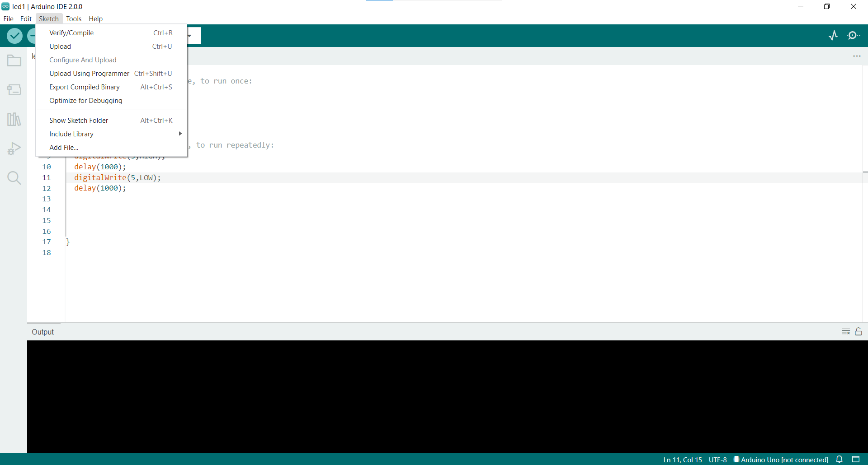
ARDUINO IDE APP SAMPLE:

Slide 16

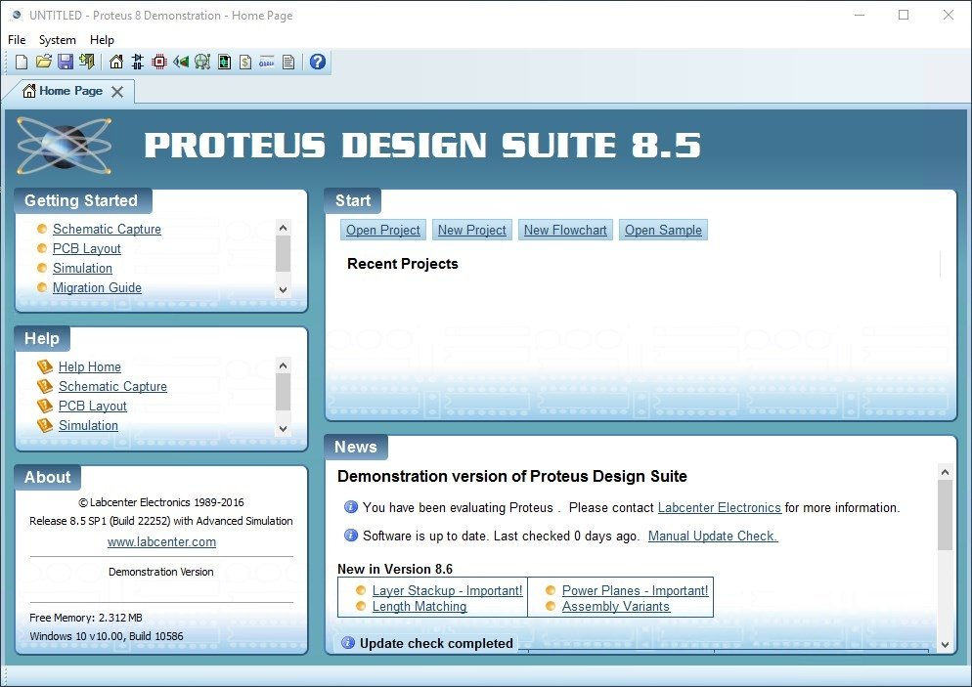
PROTEUS APPLICATION:
Figure : Proteus simulator
The Proteus Design Suite is a proprietary software tool suite used primarily for electronic design automation.
Proteus 8 supports many compilers plug-in also including Arduino. But first thing you must do is having Arduino IDE installed on your PC.
Schematic capture in the Proteus Design Suite is used for both the simulation of designs and as the design phase of a PCB layout project.

Slide 17
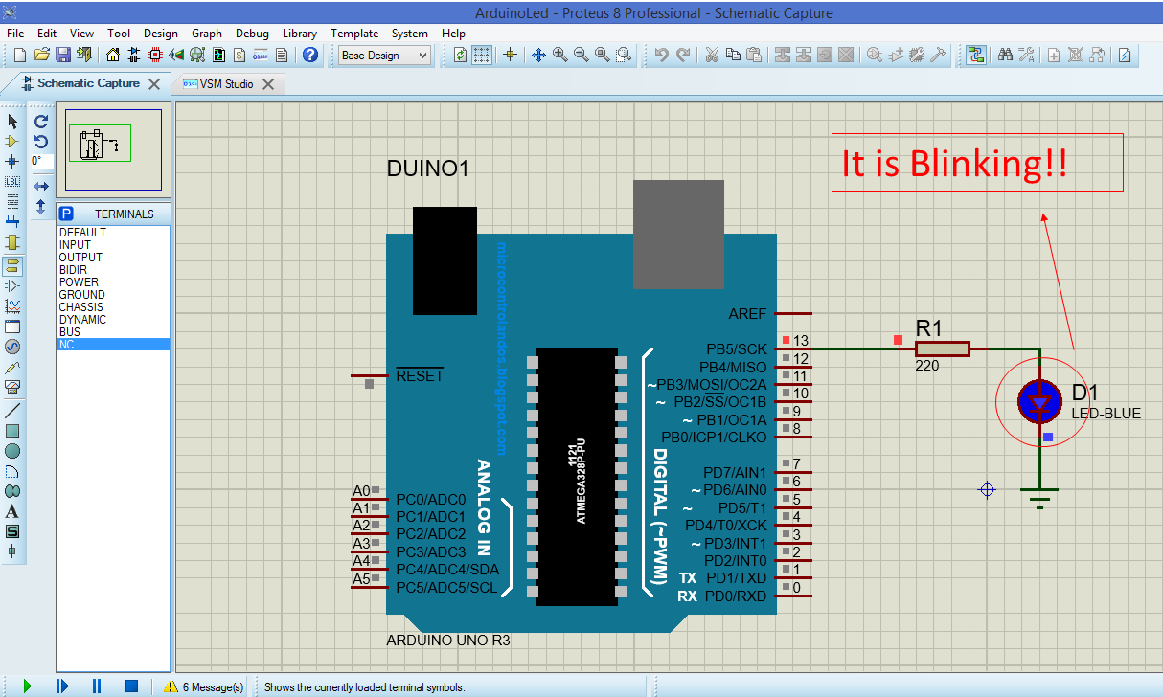
Proteus schematic capture:

Slide 18
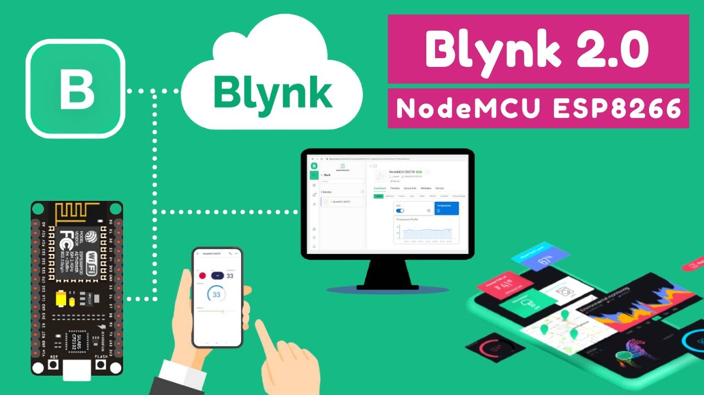
BLYNK IOT APPLICATION:
Blynk was designed for the Internet of Things. It can control hardware remotely, it can display sensor data, it can store data, visualize it and do many other cool things
Blynk is an IoT platform for iOS or Android smartphones that is used to control Arduino, Raspberry Pi and Node MCU via the Internet.
Blynk App - allows to you create amazing interfaces for your projects using various widgets we provide.

Slide 19
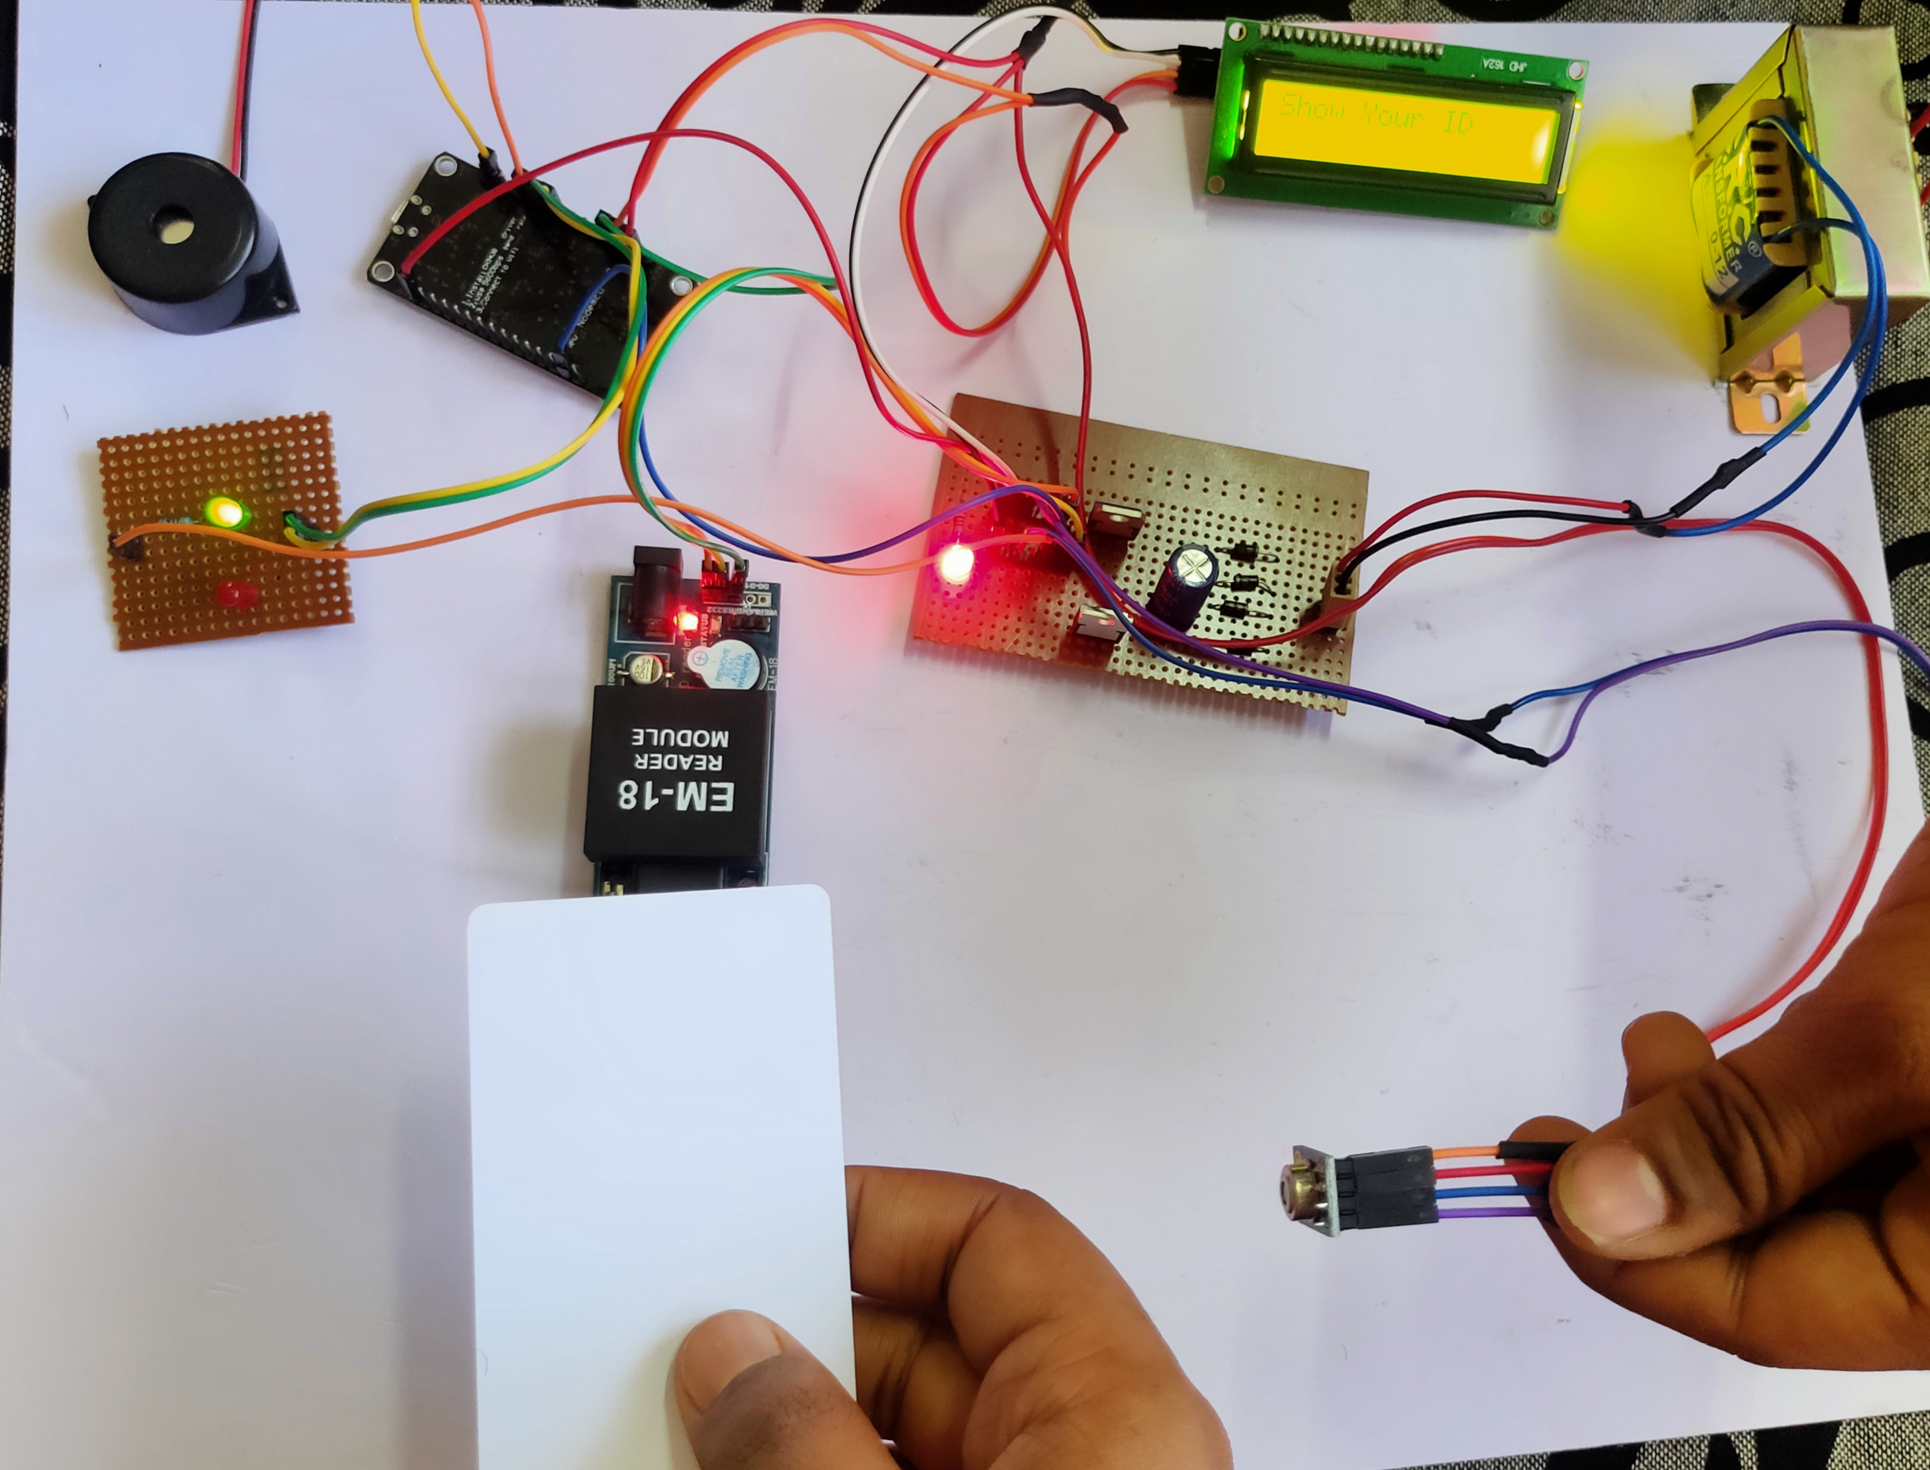
Experimental setup:
LCD Display [2x16]
NODE MCU BOARD
Step down transformer
Buzzer
LED for Alert
Power Supply circuit
EM 18 Reader Module
RFID Tag
MLX90614 temperature sensor

Slide 20
Flowchart:
start
End
Wait and connect to Wi-Fi network
Read temperature data from MLX90614
Upload Data to BLYNK APP
Show your RFID card to reader
YES
LED RED is ON
BUZZER is ON
Display data on LCD
NO
YES
If( temp>98° F)
If (Valid card)
NO
LED GREEN is ON
BUZZER is OFF

Slide 21
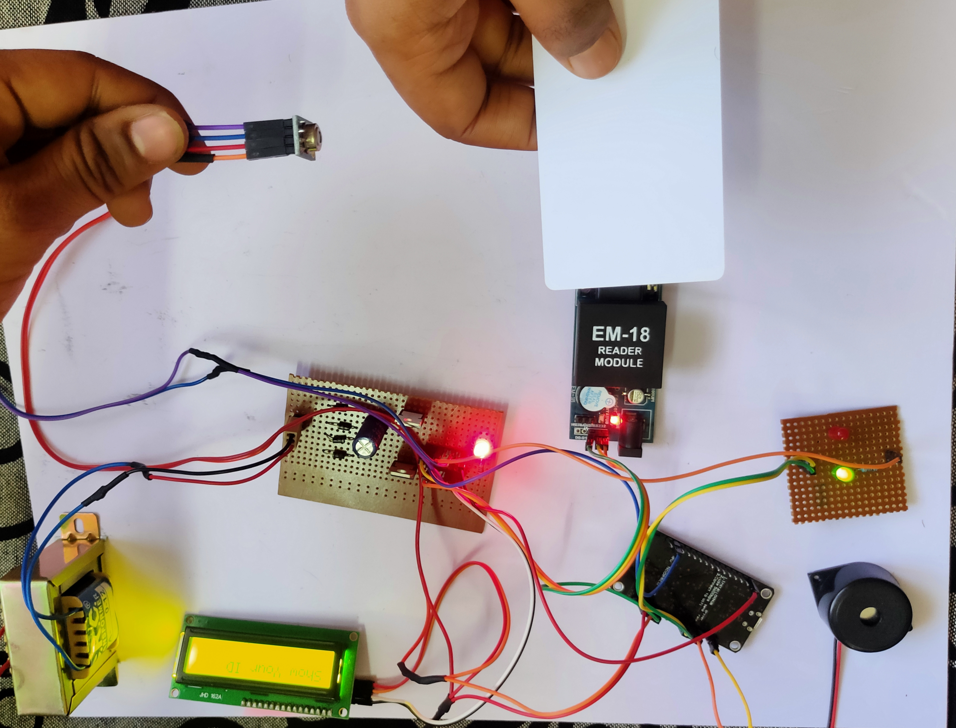
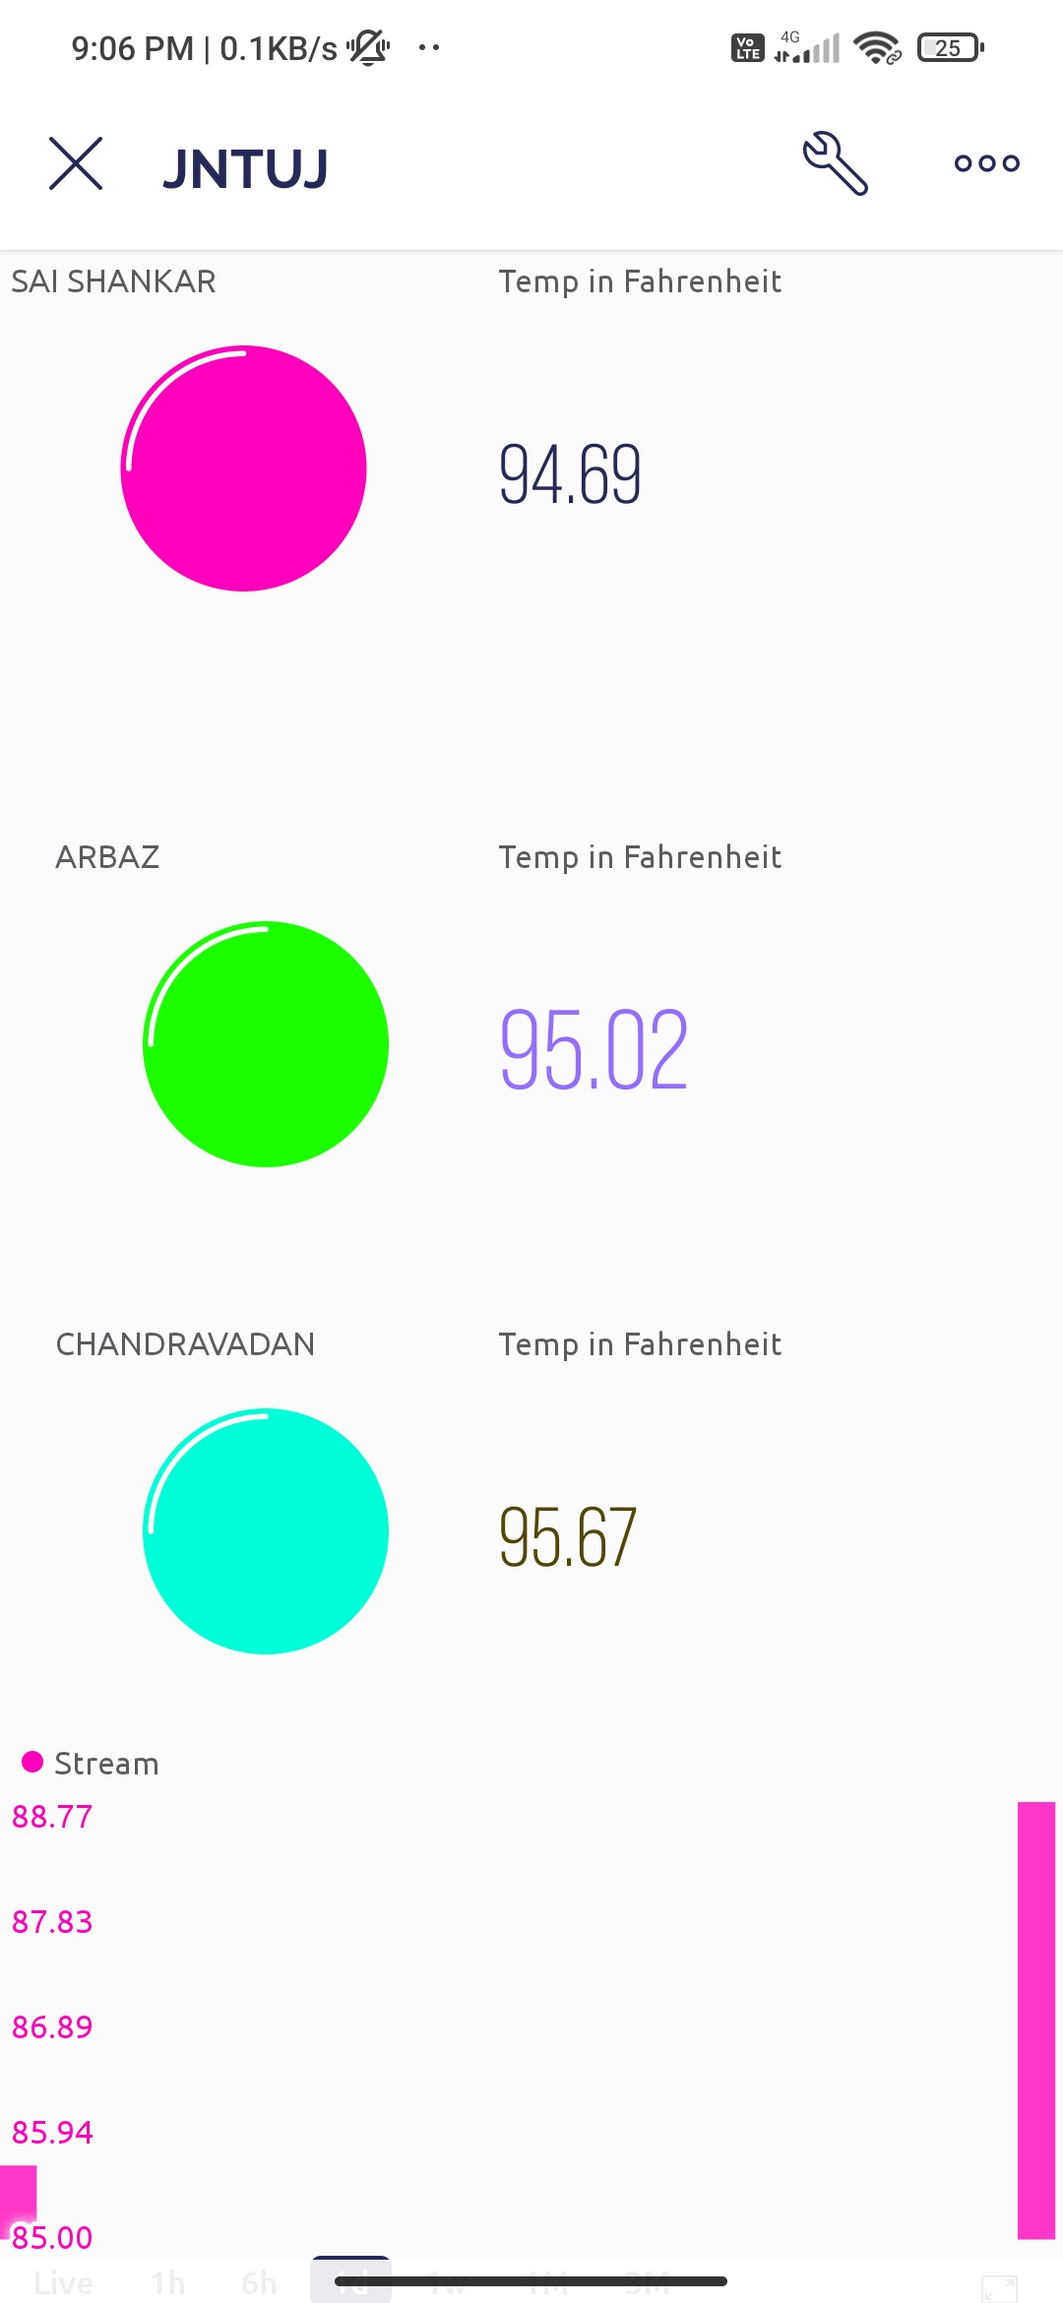
Results:
Results will be displayed on LCD and uploaded to Blynk App
BLYNK APP DASHBOARD

Slide 22
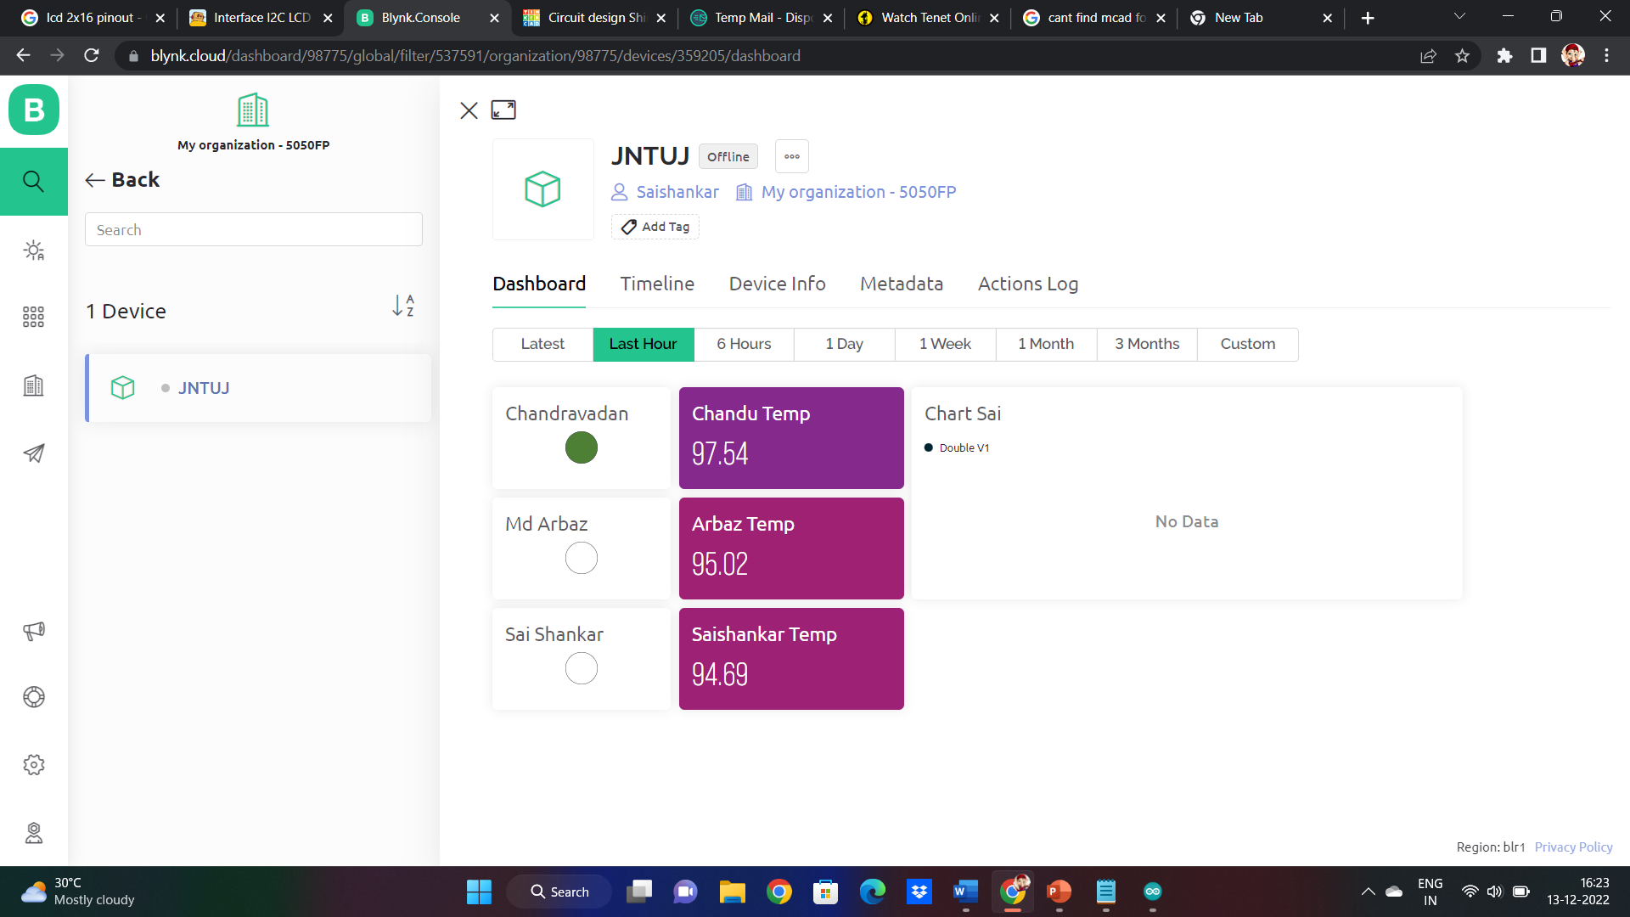
Results
Log in Blynk credentials in Blynk website and view temperature data logs remotely

Slide 23
Conclusions:
The proposed system helps to measure their body temperature and record their details without interaction with students.
Usually this system is more useful when there is need of attendance and temperature check during examinations and useful to isolate the ill students.
The implementation details of contactless temperature scanning system using Node MCU and Blynk IOT app is explained.

Slide 24
References:
Merchant, Chad. “Malaysia Significantly Eases Lockdown with Conditional MCO from May 4.” ExpatGo, 1 May 2020, www.expatgo.com/my/2020/05/01/malaysia-eases-lockdownwithconditional-mco-from-may-4/.
Abbas, A. H., Habelalmateen, M. I., Jurdi, S., Audah, L., & Alduais, N. A. M. (2019, November). GPS based location monitoring system with geo-fencing capabilities. In AIP Conference Proceedings (Vol. 2173, No. 1, p. 020014). AIP Publishing LLC.

Slide 25
THANK YOU😊

